Slide 1
INT219 CA-2
BASIC IMAGE EDITOR
submitted to:Mrs.Twinkle Chawla
Reg no:11805366
Name:Manukonda Pallavi

Slide 2
BASIC PHOTO EDITOR
image encompasses the processes of altering image, whether they are digital photographs, traditional photo-chemical photographs or illustrations. Traditional analog image editing is known as photo retouching, using tools such as an airbrush to modify photographs or editing illustrations with any traditional art medium. Graphic software programs, which can be broadly grouped into vector graphics editors, raster graphics editors, and 3D modelers, are the primary tools with which a user may manipulate, enhance, and transform images. Many image editing programs are also used to render or create computer art from scratch.

Slide 3
This one is the basic photo editor
Where you can edit your image .all you need is to just take the image link address and place into the search bar.
You can also place the link in the code or can Google as well.
In this only four features are there you can add some more as well.

Slide 4
Index html part
<!DOCTYPE html>
<html lang="en“>
<head>
<meta charset="UTF-8">
<meta name="viewport" content="width=device-width, initial-scale=1.0">
<link href="css/style.css" rel="stylesheet">
<title>Document</title>
</head>
<body>
<section class="main"> <div class="container"> <div class="main-outer"> <div class="main-left"> <aside> <h3>Image Filters</h3> <form id="slider-form"> <p> <label for="gs">Grayscale</label> <input id="gs" name="gs" type="range" min="" max="100" value="0" class="slider"> </p> <p> <label for="blur">Blur</label> <input id="blur" name="blur" type="range" min="0" max="" value="0" class="slider"> </p> <p> <label for="hue-rotate">Hue-Rotate</label> <input id="hue-rotate" name="hue-rotate" type="range" min="0" max="" value="0" class="slider"> </p> <p> <label for="sepia">Sepia</label> <input id="sepia" name="sepia" type="range" min="0" max="" value="0" class="slider"> </p> <button type="reset" >Reset</button> </form> </aside> </div> <div class="main-right“
> <form id="myform">
<input type="text" placeholder="Image URL" id="onlineurl">
<button type="submit">Change Image</button>
</form>
<div class="img-area">
<img src="images/car.jpg" id="targetimage" alt="">
</div>
</div>
</div>
</div>
</section>
<script src="js/main.js">
</script>
</body>
</html>

Slide 5
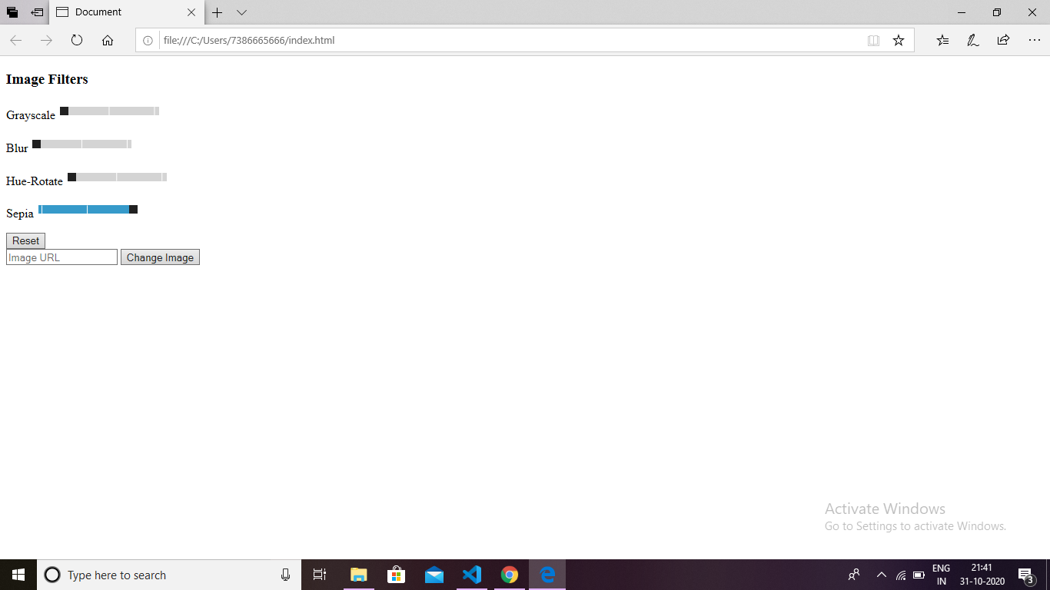

Slide 6
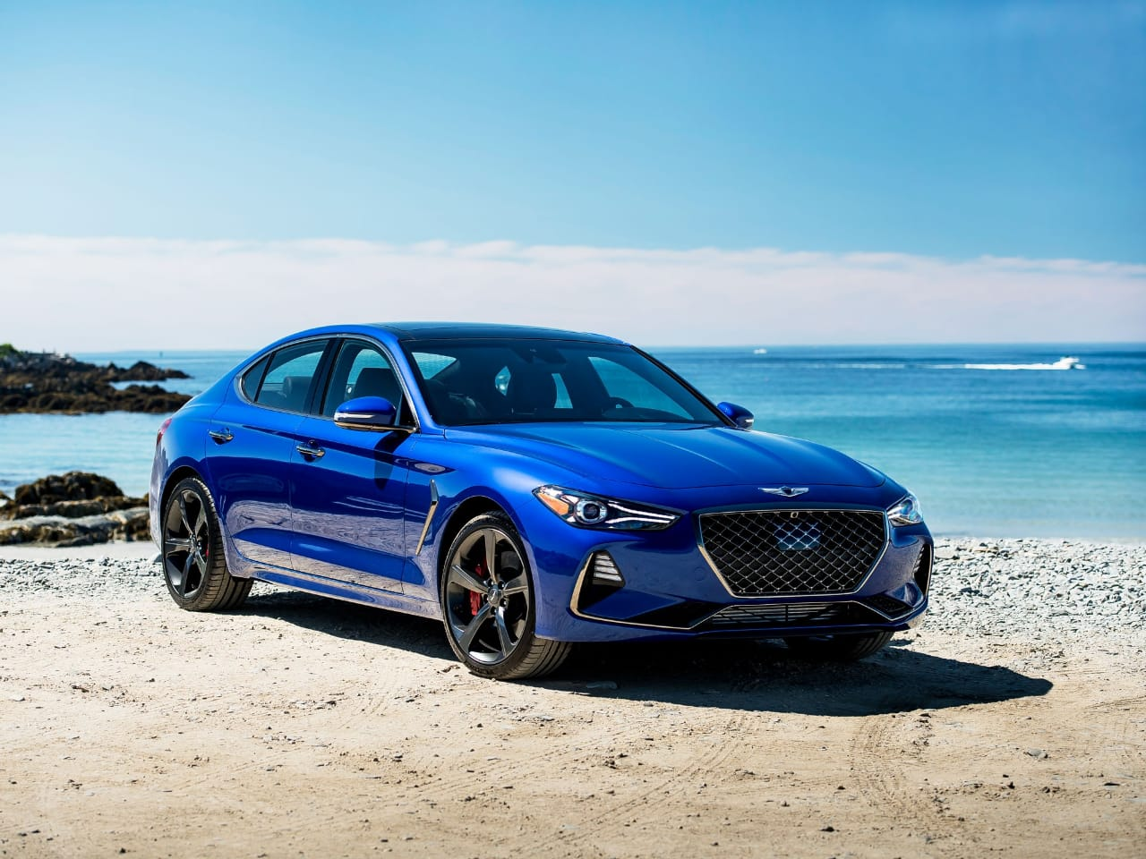

Slide 7
Js part
let myform = document.getElementById('myform');let targetimage = document.getElementById('targetimage');let inputrange = document.querySelectorAll('.slider');myform.addEventListener('submit', function(e){let urlimage = document.getElementById('onlineurl');let urlimageval = urlimage.value; if(urlimageval.length){ targetimage.setAttribute('src',urlimageval); urlimage.value = ''; } e.preventDefault(); console.log('done');};for(let i=0; i<=inputrange.length-1; i++ ){ inputrange[i].addEventListener('input', editimage);}function editimage(){ let gs = document.getElementById('gs'); let blur = document.getElementById('blur'); let huerotate = document.getElementById('hue-rotate'); let sepia = document.getElementById('sepia'); let gsval = gs.value; let blurval = blur.value; let huerotateval = huerotate.value; let sepiaval = sepia.value; targetimage.style.filter = 'grayscale('+gsval+'%) blur('+blurval+'px) hue-rotate('+huerotateval+'deg) sepia('+sepiaval+'%)';} let sliderform = document.getElementById('slider-form');sliderform.addEventListener('reset', function(){ sliderform.reset(); setTimeout(function(){ editimage(); },0) })

Slide 8
Css part
{ margin: 0;padding: 0;box-sizing: border-box; } body {font-family: Arial,Helvetica, sans-serif;overflow-y: hidden;}.main {width: 100%; float: left;}.container { width: 90%;margin: 0 auto;}.main-outer {width: 100%;float: left; padding: 3em;} .main-left {width: 25%;float: left; }.main-left aside {width: 100%;background: #333;height: calc(100vh - 6em);float: left;padding: 40px; }.main-left aside h3 {color: #fff;font-size: 30px;font-weight: normal;margin-bottom: 20px;}.main-left p {margin-bottom: 15px;}.main-left label { color: #fff;display: block;padding-bottom: 10px; }.main-left aside button {float: right; background: #fff;border: none;height: 35px; padding: 0 26px;font-size: 15px;color: #000;cursor: pointer; margin-top: 20px;}.slider { -webkit-appearance: none;width: 100%;height: 15px;border-radius: 5px;background: #d3d3d3;outline: none;opacity: 0.7;-webkit-transition: 0.2s;transition: opacity 0.2s;} .slider::-webkit-slider-thumb {-webkit-appearance: none;appearance: none;width: 25px;height: 25px;border-radius: 50%;background: #4caf50;cursor: pointer;}.slider::-moz-range-thumb { width: 25px; height: 25px;border-radius: 50%;background: #4caf50;cursor: pointer;} .main-right {width: 70%;float: right;}.main-right .img-area {width: 100%;height: 77vh;overflow: hidden;} .main-right .img-area img {width: 100%;} .main-right input[type="text"] {width: 79%;margin-bottom: 20px;height: 45px;padding: 10px;} .main-right button {float: right;background: #333;border: none;height: 45px; padding: 0 26px; font-size: 15px; color: #fff; cursor: pointer; }

Slide 9
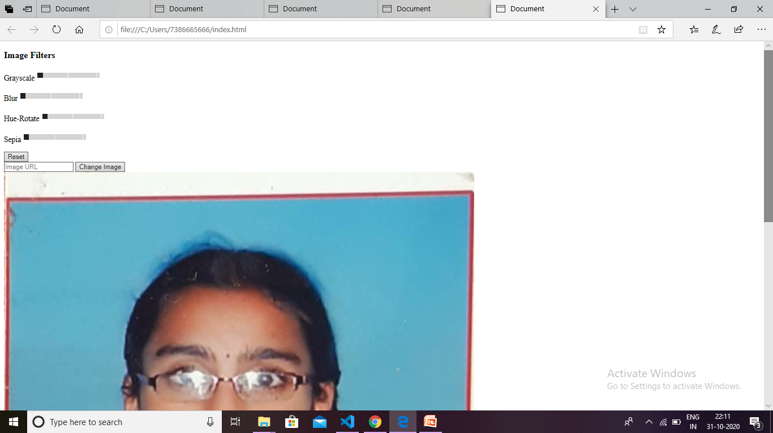
After inserting image

Slide 10
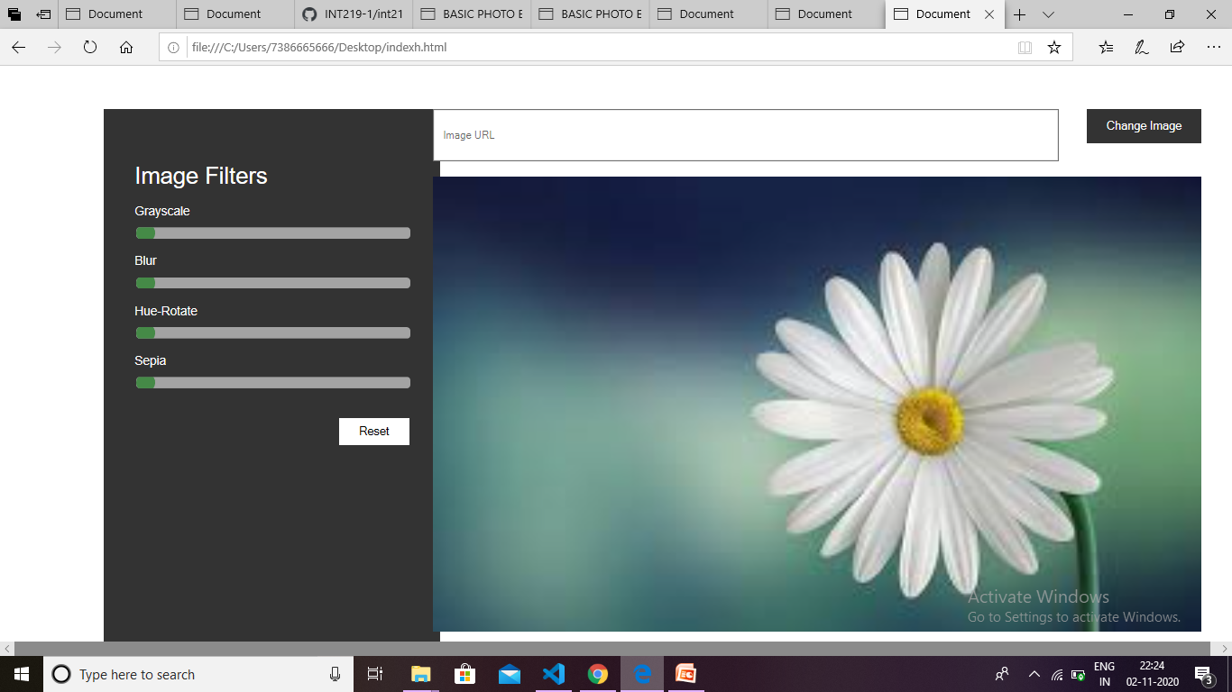
The editor

Slide 11
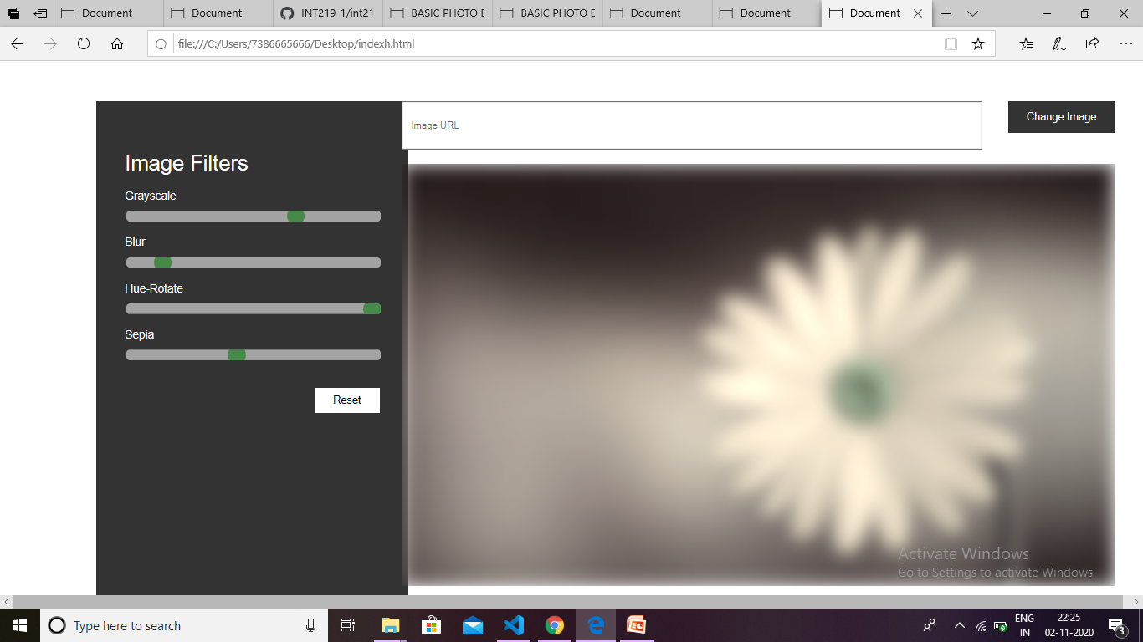
After some changes

Slide 12
First page
<!DOCTYPE html>
<html lang="en">
<style>
* {
margin: 0;
padding: 0;
}
body {
font-family: 'Baloo 2', cursive;
}
.banner-text {
width: 100%;
position: absolute;
z-index: 1;
}
.banner-text ul {
height: 50px;
float: right;
}
.banner-text ul li {
display: inline-block;
padding: 40px 15px;
text-transform: uppercase;
color: #fff;
font-size: 20px;
}
.banner-text ul li:hover {
cursor: pointer;
}
.banner-text h2 {
text-align: center;
color: #fff;
font-size: 50px;
margin-top: 20%;
}
.animation-area {
background: linear-gradient(to left, #8942a8, #ba382f);
width: 100%;
height: 100vh;
}
.box-area {
position: absolute;
top: 0;
left: 0;
width: 100%;
height: 100%;
overflow: hidden;
}
.box-area li {
position: absolute;
display: block;
list-style: none;
width: 25px;
height: 25px;
background: rgba(255, 255, 255, 0.2);
animation: animate 20s linear infinite;
bottom: -150px;
}
.box-area li:nth-child(1) {
left: 86%;
width: 80px;
height: 80px;
animation-delay: 0s;
}
.box-area li:nth-child(2) {
left: 12%;
width: 30px;
height: 30px;
animation-delay: 1.5s;
animation-duration: 10s;
}
.box-area li:nth-child(3) {
left: 70%;
width: 100px;
height: 100px;
animation-delay: 5.5s;
}
.box-area li:nth-child(4) {
left: 42%;
width: 150px;
height: 150px;
animation-delay: 0s;
animation-duration: 15s;
}
.box-area li:nth-child(5) {
left: 65%;
width: 40px;
height: 40px;
animation-delay: 0s;
}
.box-area li:nth-child(6) {
left: 15%;
width: 110px;
height: 110px;
animation-delay: 3.5s;
}
@keyframes animate {
0% {
transform: translateY(0) rotate(0deg);
opacity: 1;
}
100% {
transform: translateY(-800px) rotate(360deg);
opacity: 0;
}
}
</style>
<head>
<meta charset="UTF-8">
<title>animated background with pure css and html</title>
<link href="https://fonts.googleapis.com/css2?family=Baloo+2:wght@700&display=swap" rel="stylesheet">
<link href="dummy.css" rel="stylesheet">
</head>
<body>
<div class="banner-text">
<ul>
<a href="https:instagram/myinstagram">INSTAGRAM</a>&nbsp;&nbsp;&nbsp;&nbsp;
<a href="C:\Users\7386665666\Desktop\indexh.html">LET START EDITING</a>&nbsp;&nbsp;&nbsp;&nbsp;
<a href="https://github.com/manukondapallavi/INT219-1">CONTACT US</a>&nbsp;&nbsp;&nbsp;&nbsp;
<a href="">SUBSCRIBE</a>&nbsp;&nbsp;&nbsp;&nbsp;
<li>Contact</li>
</ul>
<h2>BASIC PHOTO EDITOR</h2>
</div>
<div class="animation-area">
<ul class="box-area">
<li></li>
<li></li>
<li></li>
<li></li>
<li></li>
<li></li>
</ul>
</div>
</body>
</html>

Slide 13
Github link
https://github.com/manukondapallavi/INT219-1
Video link
https://youtu.be/GZ_u-RYEgno

Slide 14
Resource/reference
Youtube
w3school

